Slide 1
Yield Management
Chapter 12

Slide 2
Services Versus Manufacturing
Capacity planning task more difficult
  Inventory
  Timing
Capacity planning mistakes (stock-outs) more expensive

Slide 3
Services Versus Manufacturing
Known Demand
5 5 5 5 50 30
Manufacturing capacity needed: 105/7=15
Service capacity needed?
Depends on General Service Capacity Strategy
  Provide: sufficient capacity at all times
  Match: change capacity as needed
  Influence: change demand pattern
  Control: maximize capacity utilization

Slide 4
Capacity Strategies
Capacity issues in services are:
  More complex than in manufacturing
    Timing may be important, for example if there are peaks in demand at different times of day
  More critical than in manufacturing
    Often no backorders can occur
    Excess capacity may be perishable
  An imbalance in supply and demand can result in lost sales or idle employees

Slide 5
Capacity Strategies
Influence: Alter demand patterns to fit firm capacity
  Pricing, marketing and appointment systems
Control: Maximize capacity utilization
  Compete on cost by driving idle time to zero

Slide 6
Capacity Strategies
Provide: Ensure sufficient capacity at all times
  High quality/high cost; greater amount of idle time for employees
Match: Change capacity as needed
  Balance quality/cost; part-time workers

Slide 7
Techniques for Managing Capacity
Work-shift scheduling
Increased customer participation
Adjustable (surge) capacity
Shared capacity

Slide 8
Techniques for Managing Capacity
Partitioned demand
Price incentives for and promotion of off-peak demand
Development of complementary services
Yield management

Slide 9
Managerial Options
Supply Management
  Capacity
  Work-shift scheduling
  Increasing customer participation
  Adjustable (surge) capacity
  Sharing Capacity
  Personnel – cross training, part-timers
Notes:
The material in the next few slides is from chapter 2, but it may be appropriate to use when discussing yield management.

Slide 10
Managerial Options
Demand Management
  Partitioning demand
  Price incentives
  Promoting off-peak demand
  Develop complementary services
Yield Management

Slide 11
Yield Management
“Selling the right capacity
to the right customer at the right price”
Business Requirements
  Limited Fixed Capacity
  Business environment where YM can help
    Ability to segment markets
    Perishable inventory
    Advance sales
    Fluctuating demand
    Accurate, detailed information systems

Slide 12
Industries that Fully
Use YM Techniques
Transportation-oriented industries
  Airlines
  Railroads
  Car rental agencies
  Shipping
Vacation-oriented industries
  Tour operators
  Cruise ships
  Resorts
Hotels, medical, broadcasting

Slide 13
Elements of a Yield
Management System
Overbooking
Pricing
Capacity Allocation
  Distinct versus nested
  Static versus dynamic

Slide 14
Overbooking
Two basic costs:
  Stock outs
    customers have a reservation and there
    are no rooms left
  Overage
    customers denied advance reservation
    and rooms are unoccupied

Slide 15
Example: Hotel California
  Stock outs: 0.8 x $150 = $120
  Overage: $50

Slide 16
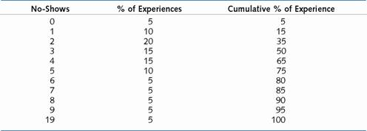
Hotel California No-Show Experience

Slide 17
Overbooking Approach 1:
Using Averages
In Table 12.1 the average number of no-shows is calculated by 0x0.05 + 1x0.10 + 2x0.20 + 3x0.15 +…+ 10x0.05 = 4.05.
Take up to four overbookings.

Slide 18
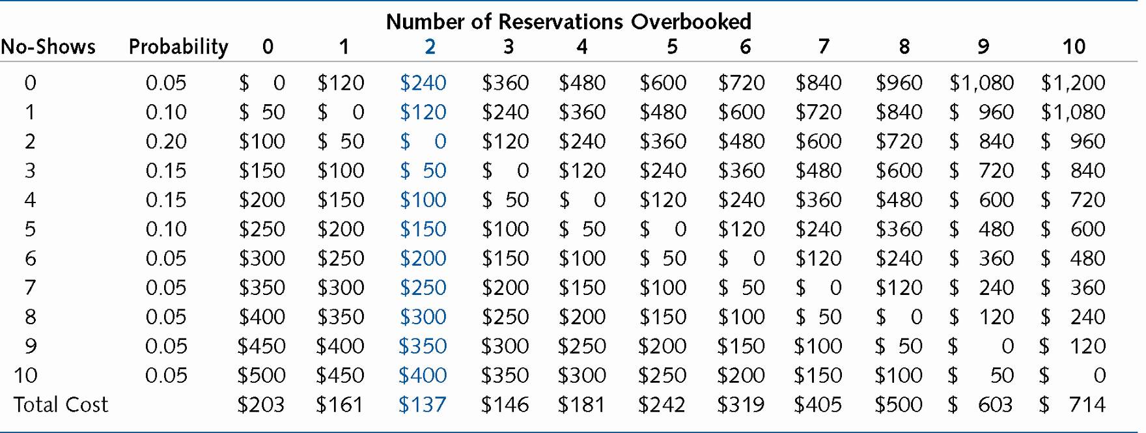
Overbooking Approach 2:
Spreadsheet Analysis

Slide 19
Overbooking Approach 3:
Marginal Cost Approach
Book more guests until:
E(cost of dissatisfied customer) = E(cost of empty room)
    Cost of dissatisfied customer *
    Probability that there are fewer no-shows
    than overbooked rooms =
    Cost of empty room *
    Probability that there are more no-shows
    than overbooked rooms

Slide 20
Example: Hotel California
Co/(Cs + Co) = P(Overbook ≥ No Shows) Hotel Data
    Cs = $120, Co = $50.00
    Co/(Cs + Co) = 29.%
      Overbook 2 rooms
Table 9.1: Hotel California No-Show Experience
No-Shows % of Experiences Cumulative % of
Experiences
0 5 5
1 10 15
2 20 35
29%

Slide 21
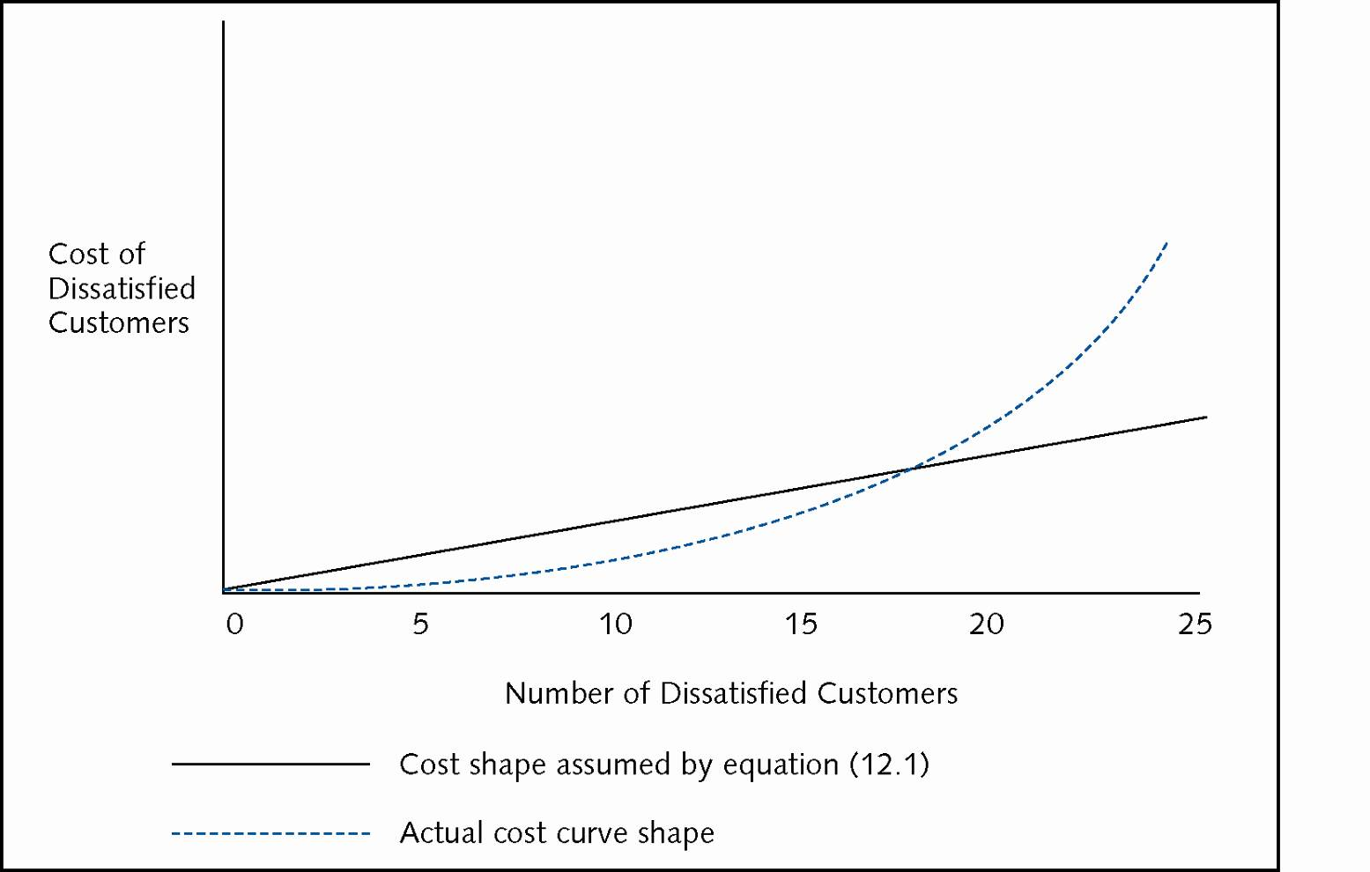
Actual Versus Linear
Overbooking Cost Curve

Slide 22
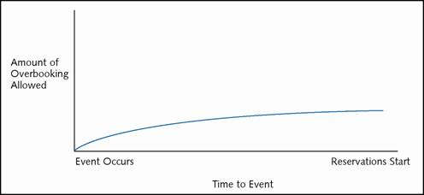
Dynamic Overbooking

Slide 23
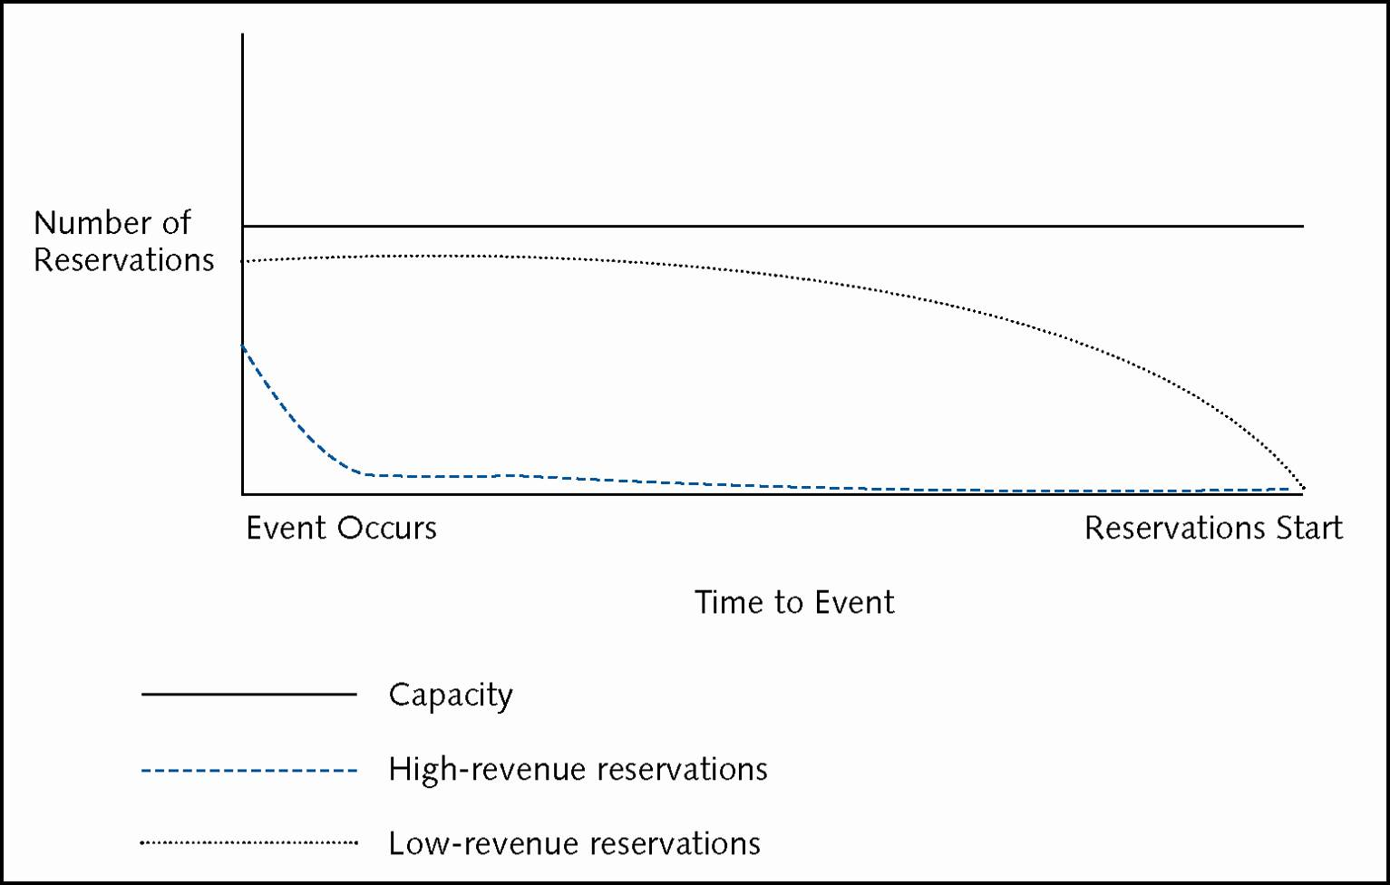
Cumulative Reservation Activity

Slide 24
Capacity Allocation with Exogenous Prices
Methods
  Nested vs. Distinct
  Static vs. Dynamic
Chapter 9 - Yield Management
18

Slide 25
Capacity Allocation with Exogenous Prices
Example (Chancey Travel)
Business capacity = 100
Demand forecast: premium profit ($10,000/seat)
demand: uniformly distributed (51, 100)
[meaning: 2% chance demand = 51, 2% chance demand = 52,…, 2% chance demand = 100, average demand = 75]
Discount price ($2,500/seat) demand:
unlimited demand at this price – infinite
discounters book earlier than premium

Slide 26
Static Methods
Fixed Number, Fixed Time Rules
    Fixed Time Rule
      Accept discount bookings until a specific date
      Motivation
      Distinct, Static System – Fixed Number Rule
      Average of 75 premium bookings, so reserve
        exactly 75 slots for premium customers
        exactly 25 slots for discount customers

Slide 27
Static Methods
Fixed Number, Fixed Time Rules
  Nested, Static system – Fixed Number Rule
  Average of 75 premium bookings, so reserve
  75 slots for premium customers
  remaining 25 go FCFS
  Example:
  85 premium and 15 passengers wish to book
  Distinct, Static system: 75 premium,15 discount
  Nested, Static system: 85 premium,15 discount
Chapter 9 - Yield Management
21

Slide 28
Nested, Static System – Fixed
Number Rule
EMSR heuristic (Expected Marginal Seat Revenue)
  Allocating first through 51st seats
  revenue per seat:
  100% certain of $10,000 premium vs. $2,500 discount
Allocating 52nd seat
98% certain of $10,000
= $9,800 expected revenue vs. $2,500 discount
Allocating 53nd seat
96% certain of $10,000
= $9,600 expected revenue vs. $2,500 discount

Slide 29
Nested, Static System – Fixed
Number Rule
  88th seat
  24% certain of $10,000 = $2,400 vs. $2,500 discount
On average flight:
75 premium passengers
13 discount passengers
12 empty seats
Optimal Allocation
87 seats premium, 13 seats discount
  Rule:
  Accept discount passenger until
  pr(spill) < discount revenue/premium revenue

Slide 30
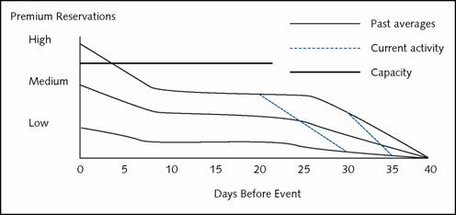
Dynamic Capacity Allocation

Slide 31
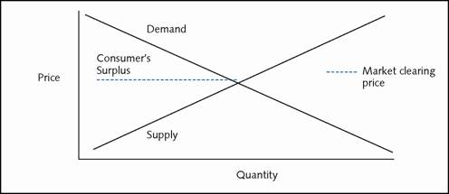
Traditional Supply and Demand Equilibrium

Slide 32
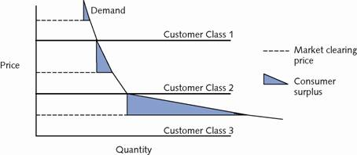
Supply and Demand Equilibrium in Yield Management

Slide 33
Pricing and Capacity Allocation
City Pair Airline Coach 7 Cheapest
Wash.-Nashville USAir $ 811 761 251
Newark-Salt Lake Cont. $1,317 571 257
Dallas-Cleveland American $ 639 471 304
Effects:
  Expands overall industry
  Shifts consumer surplus to supplier
    Two views
      Using imaginative methods to expand the economy and give consumers what they want
      Capitalist pig price gouging

Slide 34
Pricing and Capacity
Allocation – Event
Uncapacitated
Possible unit prices $100 110 90
Associated demand 100 80 120
Total Revenue $10,000 8,800 10,800
Capacitated With Two Classes
Capacity of 100
Discount class unlimited demand at $50
Premium price $100 110 90
Premium demand 100 80 100
Premium revenue 10,000 8,800 9,000
Discount revenue 0 1,000 0
Total revenue $10,000 9,800 9,000

Slide 35
Yield Management – Implementation
Alienating Customers
    Difficulty of customer understanding
    Customer cheating
Employee Issues
    Limiting decision power
    Sabotage: add, not subtract responsibility
    Reward system: in-synch with managerial goals
    - Consistency across personnel and units
    Exception processing
    Monitoring
Cost/Time of Implementation

Slide 36
Chapter Summary
Yield management systems are used in a variety of industries that have limited capacity
Components of a yield management system include overbooking, capacity allocation, and pricing
  For overbooking and capacity allocation, numerical methods can help to solve those problems
  The pricing problem still remains out of reach
The human elements of a yield management system must be attended to carefully

